Slide 1
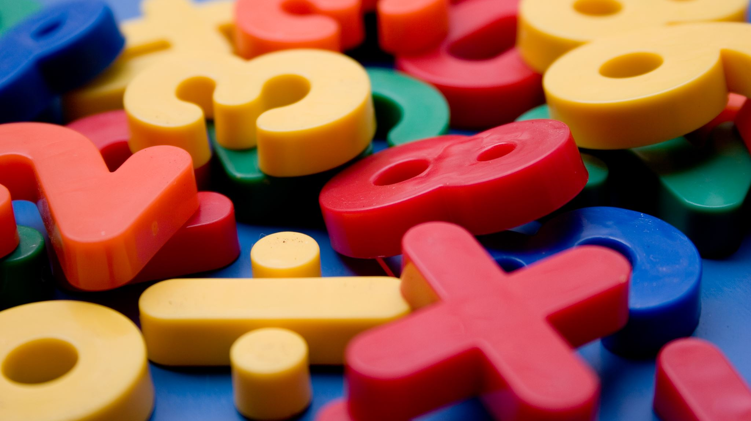
Unit-3 Maths Club
By- Dr. Meena Sharma

Slide 2
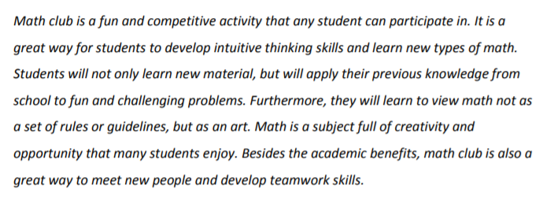
Meaning

Slide 3
Functions

Slide 4
Functions (Cont.)

Slide 5
AIMS

Slide 6
AIMS(CONT.)

Slide 7
Suggested Activities

Slide 8
Organization of the club

Slide 9
Key people

Slide 10
Duties

Slide 11
Duties(Cont.)

Slide 12
Thank you
Stay Home
Stay Safe

